Slide 1
Critical incidents & reporting Training
Fountain of Hope Family Service

Slide 2
Overview
Medical errors / adverse events
Factors contributing
Swiss cheese model
Risk
Components of risk management
Incident reporting
Fair-blame or just culture

Slide 3
Introduction and Background
Human Error- “We cannot change the human condition, but we can change the conditions under which humans work”.
(James Reason BMJ March 2000)

Slide 4
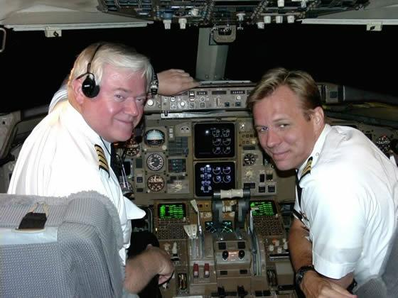

Slide 5
To err is human - USA
The Institute of Medicine (IOM) study “To Err is Human; Building a Safer Healthcare System”
Adverse events occur in 2.9 to 3.7% of all hospitalizations
44,000 to 98,000 patients dies a year as a result of medical errors

Slide 6
Extent and Nature of Adverse Events in Healthcare - (UK NHS)
850,000 adverse events per year
44,000 incidents fatal
Half are preventable
Accounts for 10% of admissions
Costs the service an estimated £2 billion per year (additional hospital stays alone, not taking into account human or wider economic costs e.g. litigation)

Slide 7
IOM Report
The IOM report made a number of recommendation on patient safety
Facilities should have a non-punitive system to report and analyze errors
A team should be assembled
Team work can improve patient safety
Safety program should be initiated using well established safety research

Slide 8
Personal vs System Approach
Personal approach
focuses on the unsafe acts
“sharp end”- name and shame
System approach
errors seen as consequence not cause
aim to build defences and safeguards
Health care – now learning from other industries
High technology systems have many defensive layers - like a Swiss cheese
Active failures
Latent conditions Reason BMJ March 2000

Slide 9
DANGER
Some 'holes'
due to active
failures
Defences
in depth
Other 'holes'
due to latent
conditions
From Reason 1997

Slide 10
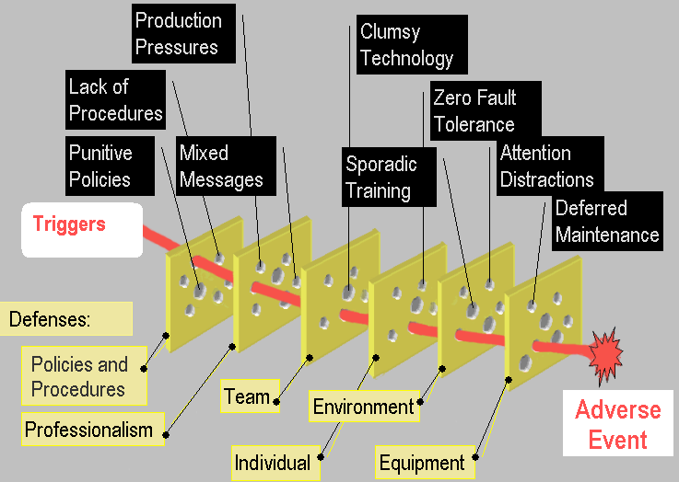
Multi-Causal Theory “Swiss Cheese” diagram (Reason, 1991)
Notes:
Pros of Swiss Cheese Model
Lots of people use the model in their slides
Depicts complexity well
Many causes linked together
Helps (somewhat) broaden discussion beyond blame and train
Helps Wisconsin dairy farmers
Cons of Swiss Cheese Model
All barriers look the same, but aren’t
Appears like “plugging” each hole is the same, but isn’t
- Stronger versus weaker
In practice with 163 VA hospitals, hundreds of RCAs
- Not useful helping dissect problems
- Not accurate in developing remedies
Leaves out important principles to fix messy systems (+/- incentives)

Slide 11
Factors Contributing to Human Error
Environmental Factors
Light
Noise and Vibration- Alarms!
Temperature
Humidity
Restrictive/ protective clothing
Equipment layout and design
Physical environment

Slide 12
Factors Contributing to Human Error
Some examples of personal factors
Fatigue
Stress
Workload
Distraction
Drugs/ Alcohol
Hypoglycaemia
Hypovolaemia

Slide 13
Discussion
If people try hard enough they will not make any errors
If we punish people when they make errors, they will make fewer of them

Slide 14
Discussion
If people try hard enough they will not make any errors
If we punish people when they make errors, they will make fewer of them

Slide 15
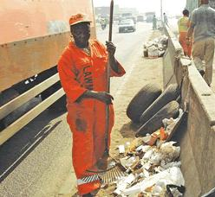
Risk
Likelihood, high or low, that some one or something will be harmed by a hazard, multiplied by the severity of the potential harm.
Risk = Severity x Likelihood

Slide 16
Risk Management
Systematic application of management policies, procedures and practices to enable the organization identify, assess, treat and monitor risk
Organizational culture – accepted as “normal practice”
“No one comes to work to make a mistake or hurt someone”

Slide 17
Components of risk management
Identification
Analysis and evaluation
Control
Review

Slide 18
Components of risk management
Identification
Incident reporting / Occurrence form
Complaints
Claims
Training
Analysis and evaluation
Control
Review

Slide 19
Components of risk management
Identification
Analysis and evaluation
Risk register
Risk scoring system or safety assessment matrix
Audit (M & M)
Root cause analysis
Control
Review

Slide 20
Components of risk management
Identification
Analysis and evaluation
Control
Policies and procedures
Audit of compliance
Staff education (induction and updates)
Review

Slide 21
Incidence reporting
Record of events
Sources of risk
Pro-active process
Near misses
Responsibility of ALL staff in the organization

Slide 22
Form
Type of incident
Occurrence
Accident
Medication error
Equipment etc.
Location
Date and time
Observed contributing factors
Observed or recorded attributable injury

Slide 23
Incidence reporting
Timely
Accurate
Errors and near-misses
Conducive environment by management
No blame versus fair-blame or just culture
Individual versus system failures
Anonymity versus feedback to reporter

Slide 24
Definitions
Incident
Accident, event or occurrence that led to harm, loss or damage to people, property or reputation
Near miss
Occurrence that could potentially have led to harm, loss or damage
Sentinel event or serious untoward incident (SUI)

Slide 25
Definitions
Adverse patient incident - any event or circumstance arising during healthcare that could have or did lead to unintended or unexpected harm, loss or damage.
Harm - injury (physical or psychological), disease, suffering, disability or death.
Incidents that lead to harm- Adverse Events.
Incidents that do not lead to harm - Near Misses.
Other terms which may be used - clinical incident, critical incident, serious untoward event, significant event
(National Patient Safety Agency 2001)

Slide 26
Incident categories
Clinical administration
Clinical process/procedure
Documentation
Healthcare associated infections
Medication/ IV fluids
Blood/Blood products
Nutrition
Oxygen/gas/ vapour
Medical device / Equipment
Behaviour
Accidents
Patients & staff
Resources

Slide 27
Levels of harm
None – near miss
Mild – minimal or short term loss of function
Moderate – intervention required, prolonged LOS, permanent or long term loss of function
Severe – life-saving or major surgical or medical intervention, shortened life expectancy, permanent or long term LOF
Death

Slide 28
Sentinel event (SUI)
Incident or accident occurring in hospital
Results in death or permanent harm to patients, staff or the public
Significant loss or damage to property or environment
Likely to be of significant public concern
Must be reported immediately or no more than 24 hrs

Slide 29
Sentinel events - types
Never events
Failure to act on a significant abnormal investigation
Unexpected death within 24 hours of surgery or invasive investigation
Death or injury following delay in undertaking necessary investigation or procedure

Slide 30
Never events
Wrong site surgery
Retained swab or instrument
Misplaced nasogastric or orogastric tube not detected before use
Maternal death from PPH after CS
Infant discharged to the wrong person
Intravenous administration of concentrated KCl
Transfusion of incorrect blood group

Slide 31
Factors Contributing to Successful Error Reporting
Culture - just, reporting, flexible, learning
Accept human fallibility – even good doctors!
Training on safety issues
Annual appraisal
Ground rules established - acceptable and unacceptable behaviour

Slide 32
Factors Contributing to Successful Error Reporting
Support / trust / leadership
Well run - good input and change implemented with good communication
Consistency
Clear instructions
Anonymity
Confidential
Voluntary

Slide 33
Barriers to Successful Reporting
Fear of individual / organisational repercussion
Defining reportable errors too narrowly
Length of contract / time in job
Workload involved - usually time (form filling)
Culture of fear of “losing an otherwise good nurse / doctor”
Where reporting has not brought about change
Uncertainty right and wrong - differing opinions

Slide 34
Tip of the Iceberg
1x
case of damage
10x
critical situations
100x
mistakes
1000x
deviation

Slide 35
General Principles of a Critical Incident Reporting System

Slide 36
General Principles of a CIRS
Learning device for continuous use
Voluntariness
No blame-culture / Just culture
Data confidentiality, confidentiality of information
Management support & resources
Anonymity
Autonomy
Simple reports
Clear definition of the contents of the reports
Analysis by experts
Feedback

Slide 37
Setting up critical incident reporting system
Policies and standard operating procedures
Culture of safety
Forms
Readily available and accessible
Encouraged to complete (emphasize preventive benefit)
Team to review incidents
Frequency – no less than weekly
Empowered
Aggregate and analyze
Management support
Feedback
Individuals
Group (Lessons of the month)

Slide 38
Fair-blame or just culture

Slide 39
System of accountability
Optimal system of accountability to support patient safety
Support of System Safety
Blame-Free Culture
Punitive Culture
Notes:
Learning objective:
On one end of the spectrum, we have Lord Denning and the punitive culture where one failure is enough to justify dismissal. This creates an environment where no one reports anything. You would just be in a place of fear all of the time. It would require that we not be human, because as humans, you and I are going to make mistakes.
At the other end of the spectrum is Don Norman and the blame-free culture. It’s not the fault of the individual; it is all the system. What does that say to our employees? Just do what you want to do, it’s all a system issue.
Some where in the middle is a system of accountability that bests supports a system of safety as applied to providers, managers, institutions, and regulators.

Slide 40
Just Culture
There are three duties
Duty to follow a procedural rules
Duty to avoid causing unjustified risk or harm
Duty to produce an outcome
Human factor design to reduce the rate of error
Anaesthesia machines and the connecting valves
Redundancy to limit the effects of failure (mistake proofing)
Balance duty against organizational and individual values

Slide 41
Just Culture
Just Culture recognizes the difference
human error (such as slips or genuine mistakes)
at-risk behavior (such as taking shortcuts)
reckless behavior (such as ignoring required safety steps like bar coding and having second person double check high risk drugs)
In contrast to an over reaching "no-blame" approach
It is important to note that the response is not based on the severity of the event
Reckless behavior such as refusing to do a time out would merit punitive action even if the patient was not harmed

Slide 42
Just Culture Accountability
Human errors – inadvertent actions like slips, lapse or mistakes
Manage through processes, procedures, training and design
CONSOLE
At-Risk Behavior- behavioral choice that increases risk where risk is not recognized or believed to be justified
Manage through removing incentives for at risk behavior and creating incentives for healthy behaviors and increasing situation awareness
COACH
Reckless Behavior- choice to consciously disregard substantial or unjustifiable risk
Manage through remedial action or punitive action
PUNISH

Slide 43
Summary
Critical incident reporting – integral part of risk management
Culture of patient safety provides conducive environment
Management support is essential and needs resources
Aggregate, analyze and act on the incidents reported
Increasing move from no blame to fair blame

