Slide 1
Setting The Stage: Preventing Violence, Trauma, and the Use of Restraint and Seclusion in Mental Health Settings
Fountain of Hope Family Services

Slide 2
  Objectives:
  To provide information on the NASMHPD Six Core Strategies
  To learn about trauma and trauma-informed care
  To hear individual experiences of restraint and seclusion
  To understand the role of peers, family and youth voice

Slide 3
Some Background…
This PowerPoint was originally presented at an OMH-led conference focused on providing information on NASMHPD Six Core Strategies to prevent violence, trauma, and the use of restraint and seclusion. Originally, NASMHPD reached out to states and hospitals that they knew had made progress, and brought groups of experienced experts from those facilities together for a series of brainstorming meetings. During this process, they found that most successful programs had implemented similar strategies, although the names and language were different. These common strategies emerged and were narrowed down to the six core strategies over time. During this time, they also began to collect every piece of literature and research available on the topic of seclusion and restraint use, violence in inpatient settings, staff development strategies, risk assessments, and consumer and staff stories about seclusion and restraint. There was a lot of opinion about seclusion and restraint in print, but very little research, so Kevin Huckshorn and a handful of other experts, including people in recovery, started to draft a training curriculum for use in hospitals serving children, youth, adults, and people in forensic settings.
The result was this curriculum in Six Core Strategies for the Reduction of Seclusion and Restraint.
The strategies were tested in two S/R grant series states and were submitted to SAMHSA’s
National Registry of Effective Programs and Practices for certification as evidence-based practices.

Slide 4
Training Overview
To recognize the role of Leadership in change
To learn how Workforce Development can influence reduction of R/S
To incorporate meaningful peer and family roles
To hear from hospitals “What Worked”
To utilize R/S Prevention Tools
To develop better Debriefing opportunities

Slide 5
First, let’s start with some data.
New York State, and certainly OMH, prides itself on its successful reduction activities. And yes, comparatively speaking, NYS uses less restraint and seclusion than other states.
This chart shows the trended number of restraint and seclusion episodes over the past three years. At the time of this presentation in 2010, the trend was increasing, especially in kids’ programs. Overall, we’d gone from 900 episodes a month to 1,300. So we had work to do.
We can always do better.

Slide 6

Facts Regarding Restraint and Seclusion Use
First, an exercise:
Please think for a moment about the first time you conducted or experienced restraint or seclusion. Think back to that day, that setting, that time. What did you see? How did you feel? What did you think? Take a moment to share that experience with someone is you’re viewing this presentation together. Where were you? Was it daytime or evening? Were you watching or actually involved? What did you feel? Did you heart race? Were you scared? Angry?

Slide 7
The New York State Office of Mental Health wishes to acknowledge
the contributions of the National Association of State Mental Health Program Directors (NASMHPD) and its Office of Technical Assistance for many of the following slides.
Many of the following slides are courtesy of NASMHPD’s Office of Technical Assistance.
We did not seek to re-create the wheel, but we did bring our own state’s perspective and experience to the concepts.

Slide 8
We currently work in mental health environments that have developed over time. Part of our inherited culture is the use of seclusion and restraint.
We do believe this is changing, but not fast enough.
Many people are still being taught that the use of restraint and seclusion are safety measures.
You still hear the term ”therapeutic hold”.

Slide 9
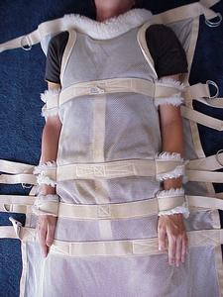
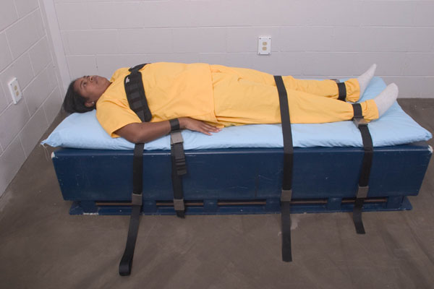


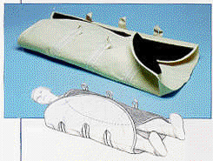
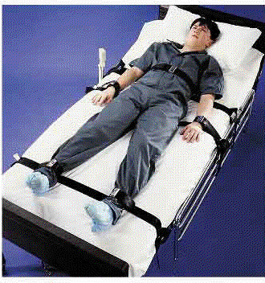
This is the reality.
One program actually called the restraint blanket at left a “taco wrap”. Kids at that program explained to OMH staff that if they misbehaved, staff would put them in the taco wrap. Needless to say, it is not used any more - and was never authorized to begin with.

Slide 10
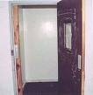
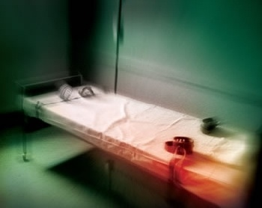
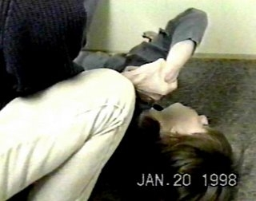
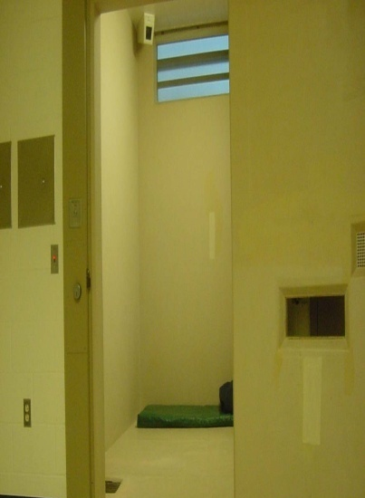
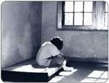
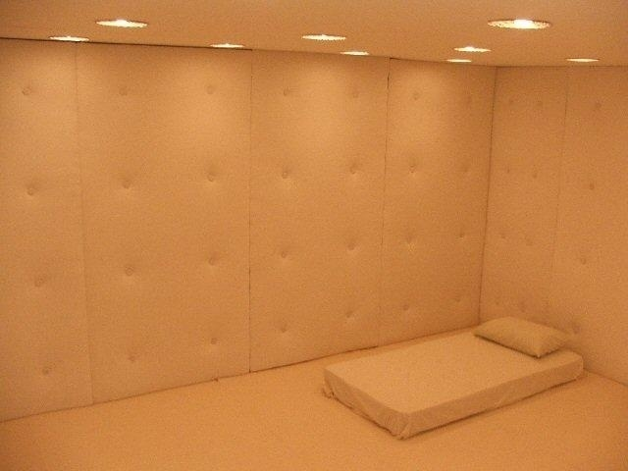
Seclusion Rooms Stark…
.
Ugly...
Barren...

Slide 11
Myth or Fact?
“Restraint and seclusion keep the people
we serve safe.”
What do you think?
In reality…
There's No Such Thing as a Safe Restraint

Slide 12
Facts!
142 deaths in the US from 1988-1998 due to R/S, reported by the Hartford Courant (Weiss, et. al, 1998) The Hartford Courant’s series of articles forever changed the way our country viewed the use of restraint and seclusion.
111 fatalities over 10 years in New York facilities due to restraints (Sundram, 1994)
At least 16 children under the age of 18 died in restraints in Texas from 1988-2002 (American-Statesman, 2003)
At least 14 people died and at least one has become permanently comatose while being subjected to R/S from July 1999 to March 2002 in California (Mildred, 2002)
50 to 150 deaths occur in the US each year due to R/S according to the Harvard Center For Risk Analysis (NAMI, 2003)
Federal Office of the Inspector General identified 42 of 104 (42%) R/S deaths from August 1999 to December 2004 were not reported as required (OIG 2006)

Slide 13
The take-home message: the number of deaths is large.
But even one death is one too many.

Slide 14
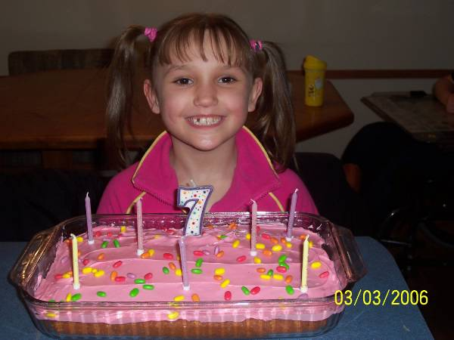
Reality
On May 25, 2006, 7-year-old Angellika Arndt died after she was restrained nine times and put in “timeout” 18 times.
One of these restraints occurred the day before her death, allegedly for “gargling milk.” The next day, she was restrained again in a face-down “control hold” for 30 minutes.
Angie had diagnoses of reactive attachment disorder, mood disorder, attention deficit hyperactivity disorder, and post-traumatic stress disorder.
Her death resulted in the closure of the program in Wisconsin.

Slide 15
Two and a half years after Angie’s prone restraint death, the state’s Disability Rights entity reported the state of Wisconsin had still not done enough to prevent similar tragedies.
http://www.disabilityrightswi.org/wp-content/uploads/2008/12/seclusion-and-restraint-paper.pdf

Slide 16
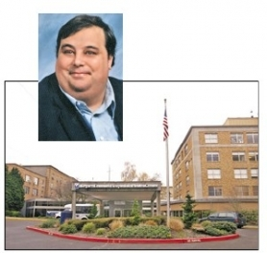
Reality
After arrival on the ward in 2007, a registered nurse entered 50 year old Glenn Shipman’s room and asked him to change from his gown into hospital scrubs.
Glenn followed her to the nurses station. A staff person blocked Glenn’s path and Glenn pushed him. Another staff person tried to push Glenn back to his room, but he refused. After more struggle, staff took Glenn to the ground to place him in a “floor-assisted restraint procedure.” And he died.
The hospital subsequently lost its TJC Accreditation.

Slide 17
Glenn’s Story
Glenn Shipman had stopped taking his medication and was increasingly delusional. When police arrived the second time, they used Taser guns on him three times, and it took six officers to subdue the 450-pound man.
At the Portland hospital, Glenn said he felt “the world was coming to an end” and that “Satan was coming.”
Glenn was known as a gentle giant by his friends and had no history of violence. But when his path was blocked soon after being admitted to an inpatient ward, he pushed staff and a struggle ensued which resulted in his death.

Slide 18
A Dangerous Assumption
Staff members, while using restraints, sometimes believe that the forceful battling by a person against those who are restraining him or her is an indication of opposition. Although it may be opposition, too often it is a struggle to breathe.
The more the individual struggles, the more oxygen the person uses, creating increasing hypoxia.
In many death cases, individuals actually suffered respiratory arrest, but the staff thought that the person had become compliant, and they held them down for a few more minutes to make certain they were calm. We have seen this in the deaths of individuals in NYS.

Slide 19
Reality
Geoffrey Hodgkins, 37, died in November 2004 after he was held face-down by seven staff at a hospital, after throwing a cup. Geoffrey was diagnosed with chronic schizophrenia and epilepsy. He had spent most of his adult life in hospital settings, had been restrained in the same position in the months before he died, and had suffered breathing problems. On the day of his death, staff pinned him in the prone position for 25 minutes until he turned blue. The hospital policy was that the technique should be used for no longer than three minutes.
Do we use prone restraint in NYS licensed or operated facilities? No, not even for three minutes.

Slide 20
Reality
On February 9, 2010 three former employees of an Ohio treatment center for troubled teens were acquitted of charges in the death of a 17-year-old girl who suffocated and choked on her own vomit after being restrained face-down on the floor.

Slide 21
In The News
In January 2010, ABC News reported a story about the deaths of three individuals caused by over-medication and chemical restraint. The California Attorney General said that one individual was drugged just for glaring, and another for throwing a carton of milk.
The watchdog Center for Medicare Advocacy says: “They're hiding the restraints. A physical restraint is visible, but a chemical restraint is not.”

Slide 22
GAO Report: School Shouldn’t Hurt
The use of seclusion and physical restraint in schools to discipline children has resulted in hundreds of possible abuse cases during the past two decades, including some ending in death, according to a government report in 2009: http://www.gao.gov/new.items/d09719t.pdf
In one case, a New York school confined a 9-year-old with learning disabilities to a "small, dirty room" 75 times in six months for whistling, slouching and hand-waving. The report details 10 children's cases, four of which ended in death. Unlike in hospitals or residential treatment centers, there's no federal system to regulate such practices in schools.
Only seven states even require that educators get training before they're allowed to restrict children, and only five states have banned "prone restraint," which ended in the death of the Texas student.

Slide 23
Federal Activity
On March 5, 2010 the House of Representatives passed a bill to impose federal rules for restricting the use of physical and chemical restraints on schoolchildren after reports that abuses of such disciplinary methods were responsible for injuries and even deaths.
House Education and Labor Committee chairman George Miller specifically cited the case of 14-year-old Killeen Middle School student Cedric Napoleon, who died in 2002 after a 230-pound Special Education teacher pinned him to the floor.

Slide 24
Cedric
Cedric had tried to leave the classroom after he was denied lunch, and was forced into a chair and restrained.
“Cedric struggled as he was being held in his chair, so the teacher put him in a face down, or in a prone restraint, and sat on him. He struggled and said repeatedly: ‘I can’t breathe,’” she said. The teacher responded, “If you can speak, you can breathe.”
“Shortly after that, he stopped speaking and he stopped struggling.”
This is one of the most dangerous false assumptions that we have also seen in NYS. “If an individual can talk, then he or she can breathe adequately”.
This is a myth.
In several of the restraint deaths in NYS, the restrained individual said they could not breathe, and staff members believed that he or she was “manipulating” them.

Slide 25
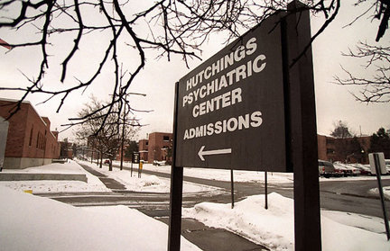
Urgency Needed: State should move quicker to stop restraints on children
By The Post-Standard Editorial Board March 05, 2010
Although the article noted that it was encouraging that the state was moving to reduce the use of restraints on children in its psychiatric hospitals, it also noted it wasn’t soon enough or fast enough.
Nonetheless, the creation of a comfort room with bean-bag chairs, weighted blankets, soothing lights and music has been one of Hutchings’ most effective strategies.
Their new hospital has wider hallways, dedicated classroom space, bigger day rooms and much more space for activities and programming, all designed to foster a more therapeutic and relaxing environment where restraints will get little use.

Slide 26
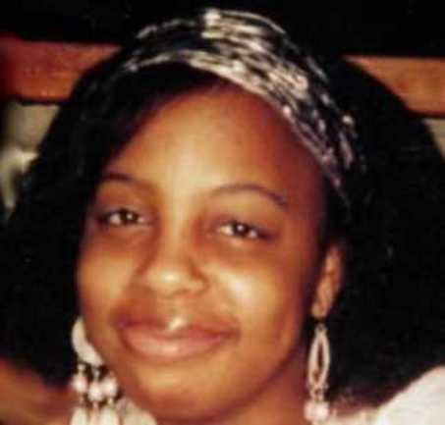
Reality
Faith Finley, 17, suffocated after being restrained in a face-down position that has been banned by one Ohio state agency.
At the time of this initial presentation in 2010, prone restraint had been blamed for the deaths of at least 40 children in facilities nationwide since 1993.
Faith’s death in 2008 was ruled a homicide.

Slide 27
In New York State
A 43-year-old man was kicked by another individual in the hospital and became enraged. Staff attempted to escort the man away, but he broke away, and when staff attempted to restrain him, he fell to the floor. He was restrained in a prone position, continued to struggle, and died.
A 36-year-old man exhibiting aggressive behavior died in a CPEP following a manual prone restraint involving police.
Remember: The police do not monitor vital signs. You are still responsible for your patient.

Slide 28
“Well, that’s Texas”
It’s easy to look at these cases and think: “Not in New York…that’s Texas, and don’t they send individuals with developmental disabilities to the electric chair?”
But it does happen in New York.
It can happen anywhere.

Slide 29
In New York State
A 14-year-old girl’s arm was broken while being restrained at an RTF. She was subsequently admitted to an Article 28 hospital, where she was again restrained and her arm fractured for a second time.
A 10-year-old girl was injured when she was restrained at an RTF for refusing to sit. Two staff members were also injured.
Restraints of children are often precipitated by their failure to follow a rule - a rule which is often not that important to begin with.

Slide 30
NYS Injuries reported to NIMRS
At least nine children were injured during restraint and seclusion in OMH operated and licensed programs from 2000 to 2009. That included one life-threatening injury.
Sixteen adults were seriously injured during the same period, two with life-threatening injuries.
These numbers did not include other incident reports which showed other serious injuries and four adult deaths.

Slide 31
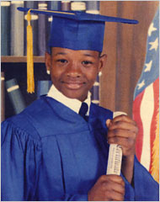

Darryl Thompson
15-year-old Darryl died from an irregular heartbeat after being restrained face-down by two aides at a NYS OCFS juvenile facility in 2007.

Slide 32
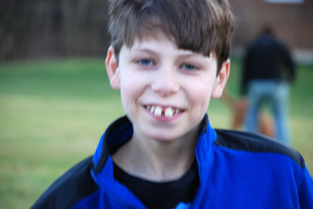
Jonathan Carey
In February 2007, a skinny kid with autism was smothered to death at the age of 13 during an improper restraint.
An OMRDD aide was convicted of manslaughter.
Enacted in May 2007, Jonathan’s Law requires hospitals to share investigations and incident reports with parents and the individual in care.

Slide 33
Reported Injuries and Deaths
The risks are clearly high…
Injuries including:
  Coma
  Broken bones
  Bruises
  Cuts requiring stitches
  Facial damage
  Mildred, 2002
Deaths due to:
  Asphyxiation
  Strangulation
  Cardiac arrest
  Blunt trauma
  Drug overdoses or interactions
  Choking

Slide 34
Myth or Fact?
“Restraint and seclusion keep staff safe.”
It’s a myth.
It is now the professional consensus that the best way to reduce restraint deaths and injuries is to reduce restraint use to the greatest extent possible.
It is not about doing them safely.
It is about not doing them.

Slide 35
Facts
For every 100 mental health aides, 26 staff injuries were reported in a three-state survey. The injury rate was higher than what was found among workers in:
  Lumber
  Construction
  Mining industries (Weiss et al, 1998)
This is alarmingly high.

Slide 36
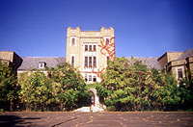


Reality
MH worker Jean-Max Auguste, 50, was kicked in the chest during a restraint in 2002 at Greystone Park Psychiatric Center in New Jersey and died.
MH worker Lee McDuffy, 39, collapsed and died after physically restraining someone at Spring Grove Hospital in Maryland in 2006.
As you can see, physical interventions
are dangerous for the individuals we serve,
and for our staff.

Slide 37
Reality
Staff training to reduce the use of restraints resulted in:
  13.8% reduction in annual restraint rates
  54.6% decrease in average duration of restraint per admission
  18.8% reduction in staff injuries
  (Forster, Cavness, & Phelps, 1999)
Staff training to avoid restraint and seclusion does have a positive impact. It is important that the training not focus on physical intervention safety but on avoiding its use.

Slide 38
Myth or Fact?
“Restraint and Seclusion is only used when absolutely necessary and for safety reasons.”
Practice guidelines and state laws in place before the 2014 promulgation of 14 NYCRR Part 526 have long suggested that people be treated using the least restrictive methods available. Seclusion and restraint are to be limited to only when absolutely necessary to address immediate, serious safety concerns.
But was this being practiced? No.

Slide 39
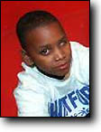
Andrew McClain
Andrew was 11 years old and weighed 96 pounds when two aides at Elmcrest Psychiatric Hospital sat on his back and crushed him to death.
His offense?
Refusing to move to another breakfast table.
Andrew died because he refused an order from a man he had never met who had not read his record.

Slide 40
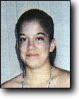
Edith Campos
Edith Campos, 15, suffocated while being held face-down after resisting an aide at the Desert Hills Center for Youth and Families.
Her offense?
Refusing to hand over an “unauthorized” personal item. The item was a family photograph.

Slide 41
In New York State
1,040 surveys were received from individuals following their hospitalization in an OMH facility.
More than half had experienced physical restraint.
Of the 560 who had been restrained or secluded:
  73% stated that at the time they were not dangerous to themselves or others
  75% of these individuals were told their behavior was “inappropriate” (not “dangerous”)

Slide 42
Myth or Fact?
“Unit staff know how to recognize a potentially violent situation.”
This is a myth.
Holzworth & Willis (1999) conducted research on nurses’ decisions based on clinical cues of patient agitation, self-harm, inclinations to assault others, and destruction of property.
Nurse responses matched only 22% of the time.
Nurses with the least clinical experience (less than 3 years) made the most restrictive recommendations.

Slide 43
Reality
Research indicates that, at best, trained mental health professionals alone can predict the potential for violence somewhat better than chance (53%).
(Mossman, 1994; Lidz, Mulvey & Gardner, 1993; Janofsky, Spears, Neubauer, 1988)
Since we cannot predict violence, we are hard-pressed to make the argument that restraint is needed because someone may become violent.

Slide 44
Myth or Fact?
“Staff do not always know how to de-escalate potentially
violent situations.”
This is a fact.
Do we have the experience? Are we great at helping individuals calm? If the front desk comes running in, saying there’s an individual in the lobby wielding a knife shouting he’s Satan, how many of us would jump up and say “I got this!”?
We don’t hire for these skills, teach to it, mentor it, or assess competency for it.

Slide 45
Facts
In 2001, Petti et al analyzed content from 81 debriefings following the use of seclusion or restraint.
  …36% blamed the individual
    Example: “He could have listened and followed instructions”
  …15% took responsibility
    Example: “I wish I could have identified his early escalation”
Another 15% provided no response, and 12% were at a loss!
“I don’t see anything else…all alternatives used.”

Slide 46
Reality
A behavioral analysis in a child and adolescent inpatient setting was conducted to explore variables related to mechanical restraints.
The most frequent antecedent was a staff-initiated encounter.
(Luiselli, Bastien, and Putnam,1998)
…Maybe due to the kid not following a rule?

Slide 47
Reality
An analysis of 221 reported incidents of aggression and violence over six months in three acute psychiatric units found that de-escalation was used as an intervention less than 25% of the time. (Duxbury 2002)
NYS NIMRS data from 2007 revealed that limit-setting was the most frequently employed “least restrictive intervention”.
Does limit-setting help you calm down? It sure as heck wouldn’t help me.
And talking a walk, quiet time, environmental change, and sensory modulation are infrequently used.

Slide 48
TJC Sentinel Event Database
of Restraint Deaths
The trend of restraint deaths was not decreasing. The data was based on voluntary reporting, so it’s a safe assumption there was undercounting.
TJC found that the most frequent contributing factor to restraint deaths was a lack of basic staff orientation and training in managing behavioral crises.

Slide 49
Training
Although OMH requires a comprehensive initial two-day training program with an annual review component on preventing and managing crises, an audit by the State Comptroller in 2002 found that 31% of the direct care staff sampled were out of compliance with the annual review requirement.
You can have the best training program in the world, but if you don’t ensure staff receive it, it’s worthless!

Slide 50
Training
OMH offers a Train-the-Trainer the program in PMCS its state-of-the-art program in preventing conflict. It’s offered free of charge to licensed programs.
Contact the OMH Bureau of Education and Workforce Development at (518) 549-5350 if you are interested in having your trainers attend a program. They are offered in every region.

Slide 51
Myth or Fact?
“Restraint and seclusion are not used as, and are not meant to be, punishment.”
It’s a myth.
  “Physical punishment consists of infliction of pain on the human body, as well as painful confinement of a person as a penalty for an offense”. Really, that’s exactly what restraint and seclusion are.
  The involuntary overpowering and isolation of a person and placement and maintenance of the person in restraints are aversive events from both the standpoint of logic and from that of the victim.

Slide 52
Reality
One year after discharge, 41 people who had been secluded during their hospitalization were asked to draw pictures related to their experience.
  20 of 41 spontaneously drew pictures of their seclusion room experience, although none were specifically asked to do this.
  Their responses revealed themes associated with fearfulness, terror, and resentment.
(Wadeson & Carpenter, 1976)

Slide 53
It’s About Trauma
Treatment interventions should support recovery. Yet, the high rates of trauma history among individuals in our hospitals remain unaddressed. Restraint and seclusion are re-traumatizing.
Research - long ignored - has supported this effect. The Wadeson & Carpenter study revealed seclusion as the most vivid memory. It is what stayed with them after their hospitalization.

Slide 54
Raven, an adolescent in one of our psychiatric centers in Brooklyn, conducted a survey in 2006.
Youth reported when they were secluded they felt like they could not breathe, and they were closed out from the world.
One said they felt like an animal, that they wanted to die.
One said she felt like she was locked up in jail.

Slide 55
Reality
One study found that people who were secluded experienced vulnerability, neglect, and a sense of punishment.
People who were secluded said that “anger and agitation were the result of being placed in seclusion”.
They expressed feelings of fear, rejection, boredom and claustrophobia.
(Martinez et al., 1999; Mann, Wise, & Shay, 1993)
Again, the impact of seclusion was felt
long after the hospitalization.

Slide 56
Reality
The Cambridge Hospital Child Assessment Unit analyzed 28 episodes of physical restraint (manual “holds”) under five minutes over three months.
68% of holds were less than one minute.
But children perceived the duration to be anywhere from five minutes to an hour!
Later interviews revealed that the intensity of affect
(fear, rage) returned.

Slide 57
Take-home message:
Even brief “holds” are damaging.

Slide 58
Reality
Six studies reported that 58-75% of those secluded felt they were being punished by staff.
Many believed that seclusion was used because they refused to take medication or participate in the treatment program.
Frequently, they did not know the reason for seclusion!
  (Kaltiala-Heino et al, 2003)

Slide 59
Reality
NYS survey found that 94% of those secluded or restrained had at least one complaint about their experience.
  62% did not feel protected from harm
  50% alleged unnecessary force
  40% felt they had been psychologically
  abused, ridiculed or threatened
Ray, Myers, & Rappaport, 1996

Slide 60
Reality
“The number and seriousness of former patients’ complaints about the use of these interventions could be largely predicted by whether or not they believed that staff (prior to placing them in restraints or seclusion) had first tried to calm them down and solve their problems in another manner.”
Ray, Myers, & Rappaport, 1996
Brylin Hospital was one of our three PARS grant sites. They significantly reduced their use of restraint and seclusion. While this was occurring, they went from a facility with one of the highest rates of allegations of abuse and neglect in the state, to one of the lowest.
Similarly, this study found that if the individual felt that staff tried to help them resolve their problems, they did not complain or allege abuse.

Slide 61
Myth or Fact?
“Seclusion and restraint are used without bias and only in response to objective behavior.”
That’s a myth.
Research indicates that cultural and social bias may exist.
Those more likely to be restrained are:
  Younger and on more medications (LeGris, Walters, & Browne, 1999)
  Younger, male, and African-American or Hispanic
  (Donovan et al, 2003; Brooks et al, 1994)
  - Of Black and Asian descent (Price, David & Otis, 2004)

Slide 62
Bias
As noted earlier, little agreement exists among nurses making decisions to restrain; therefore, other factors must contribute to these decisions.
Unfortunately, it appears that bias toward restraint of the young, the chronically ill, and the ethnically different may contribute to these decisions as well.

Slide 63
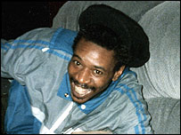
David “Rocky” Bennett
Rocky died at the age of 38 in 1998 during restraint in a British hospital.
He was racially abused by a white peer
in the hospital and he lashed out at a nurse. He was held in a prone restraint by five staff members for 25 minutes, and he died.
An inquest into his death found significant “institutional racism” in the National Health Service.
This tragedy lead to an overhaul of the British mental health system.

Slide 64
Change
Rocky’s death lead to a national five-year plan,
Delivering Race Equality in Mental Health Care,
to be fully implemented by 2010.
Recommendations included limiting restraint time to less than three minutes and addressing institutional racism
  http://webarchive.nationalarchives.gov.uk/20130107105354/http:/www.dh.gov.uk/en/Publicationsandstatistics/Publications/PublicationsPolicyAndGuidance/DH_4100773

Slide 65
Other studies
Data from a Pennsylvania study showed that females were restrained at a higher rate than males. (Karp, 2002)
A report from CMS stated that children were restrained at much higher rates than adults.
NYS OMH NIMRS data at the time of this presentation showed children and adolescents being restrained and secluded three times more than adults.

Slide 66
Reality
Fisher, an NYS OMH facility Clinical Director, concluded that factors that had a greater influence on the use of seclusion were:
    Clinical biases
    Staff role perceptions
    Administrator attitudes
    Cultural disparities
    (Fisher, 1994; Busch & Shore, 2000)
This was supported by later Harvard Review data.

Slide 67
Leading reviewers concluded that cultural bias, staff role perceptions and administrator attitudes may have more to do with the use of restraints than clinical factors related to the individual in care!

Slide 68
Myth or Fact?
“Restraint and seclusion are ‘therapeutic interventions’
and are based on clinical knowledge.”
This is a myth.
There is no such thing as a therapeutic hold.

Slide 69
Cochrane Review (2000)
  2,155 articles, no controlled studies
  Restraint and seclusion efficacy and therapeutic value not established
  Serious adverse effects cited

Slide 70
A Failure in Treatment
Data and literature review reveals no evidence base to support the use of restraint and seclusion.
Data and literature review identifies harmful effects of restraint and seclusion for recipients and staff.
NASMHPD Medical Directors Council concluded:
Restraint and seclusion “are not therapeutic”
and reflect a “failure in treatment”

Slide 71
Seclusion perceptions
A 2004 study of in three units found that…
Nurses believed seclusion was:
  Very necessary
  Not very punitive
  Highly therapeutic
Recipients believed seclusion:
  Was used frequently for minor disturbances
  Was used so staff could exert power and control
  Made them feel punished
  Had very little therapeutic value
  (Meehan, Bergen & Fjeldsoe, 2004)

Slide 72
Survey your staff anonymously.
If you understand their attitudes, you can help them change.

Slide 73
Reality
Semi-structured interviews with 24 previously secluded people indicated:
  21% described it as dehumanizing and humiliating
  16% commented on loneliness and isolation
  54% reported nothing beneficial
(Binder & McCoy, 1983)

Slide 74
Dehumanizing, humiliating, loneliness, fearfulness, and isolation are all feelings repeatedly reported in studies of responses from those to secluded and restrained.
These are powerful feelings to instill in a setting that is supposed to help!

Slide 75
Reality
A 2001 study of classroom interventions with adolescents with mental retardation found that when physical restraint was used as a consequence for inappropriate classroom behavior, rates of problem behavior increased in all sessions for each student. Playing and positive behavior also decreased.
(Magee & Ellis, 2001)

Slide 76
“Consequences” is often a fancy word for punishment.
That doesn’t mean individuals shouldn’t make amends for their behavior.
But consequence is often just punishment.

Slide 77
What’s Wrong With Seclusion?
  When asked what was bad about seclusion, 42% commented on the physical starkness, the lack of a toilet and running water, sleeping on a mat on the floor
  The majority reported that seclusion bothered them more than any other experience in the hospital
  (Binder & McCoy, 1983)

Slide 78
Reality
Punitive and isolating behaviors tend to be associated with a significant increase in negative behaviors and significant decrease in positive behaviors.
(Natta et al, 1990)
It is well-known that punishment does not work.

Slide 79
The SHU
The worst punishment deemed possible in prisons is seclusion -- solitary confinement.
In psychiatric hospitals, people who behave inappropriately are placed in seclusion.
Perhaps the only difference is that in psychiatry we call it “therapeutic”.

Slide 80
What We Now Know
Numerous unfounded beliefs exist
Harm in restraints and seclusion are well documented; positives are not substantiated
Biases exist in the system
Restraint and seclusion are not evidence-based practices
A significant culture change is required

Slide 81
Looking at the history, the beliefs, the lack of research and the facts, no wonder regulators have taken a stronger stand.
No wonder these interventions have come under scrutiny.
It is more than time to revamp our hospital cultures, to move beyond our “comfort zone” and move toward new treatment approaches based in the principles of recovery and sanctuary, free from coercive methods such as seclusion and restraint.

Slide 82
Research on Violence Causality and the Role of the Environment
Violence in mental health settings has been blamed on the “patient” for many years.
Hundreds of studies on “patient” demographics and characteristics have been conducted.
Findings are completely variable and inconclusive.
More recently, studies have looked at the role of the environment in violence, including staff.
(Richter & Whittington, 2006; Johnstone & Cooke, 2007)

Slide 83
Past research has focused on evaluation of the patient for risk factors for violent behaviors. However, this focus is severely limiting as it ignores environmental factors. Conflict and violence in inpatient mental health settings is complicated and multifactorial.
Human behavior does not occur in a vacuum.

Slide 84
Promoting Risk Interventions by Situational Risk Management
Situational factors refer to features or characteristics of the environment in which they occur.
These can include the physical setting, personal comfort, staff issues and attitudes, physical space, privacy, noise levels, unit activity levels, individual need for freedom, and other issues.

Slide 85
When we think about the causes of violence and aggression,
we need to think beyond individual characteristics such as demographics and diagnoses.
It is not about “them” and their behavior. We need to consider physical space, privacy, noise levels, activity level, staff issues and attitudes. We need to consider our role in eliciting violence.
This is not a new concept, just one that has been ignored
for many years. It is easier to say it’s about them, because
then we don’t have to do anything about it.

Slide 86
Exercise
Please think for a minute about what you do when you get home from work. Is it important to you to check on the kids’ homework? Do you read the paper first thing? Take a walk? Have a snack? Watch the news?
How would you handle being told that you could not do any of the things that were important to you because they were “not allowed”? And not for just a day, but for many days? Perhaps you even get to see others being able to do your requested activity?

Slide 87
Well -- the loss of those freedoms, those choices, is a daily occurrence in our settings.

Slide 88
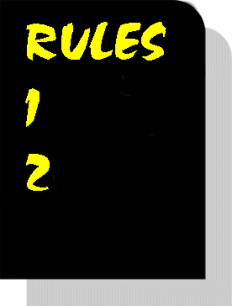
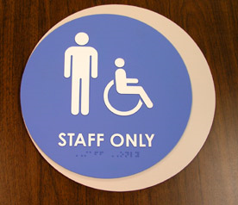
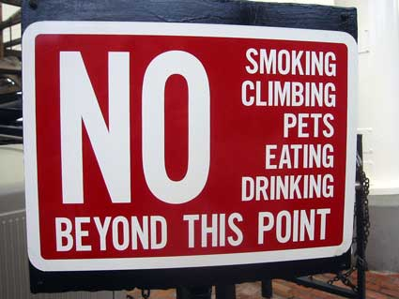
Power and Control is Everywhere

Slide 89
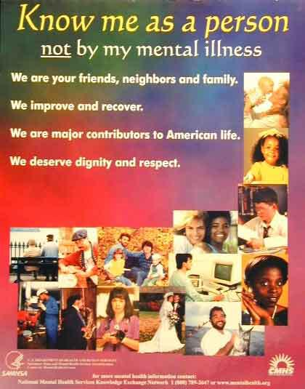
What to Do Instead
We Need
New language
New beliefs
New rituals and traditions

Slide 90
What’s our Goal?
To manage the risk of conflict and violence, as without those, neither seclusion or restraint are likely to occur.
As leaders in this effort it is going to be your challenge to come up with strategies to help your staff do this prevention work.
And as we do so, we move…

Slide 91
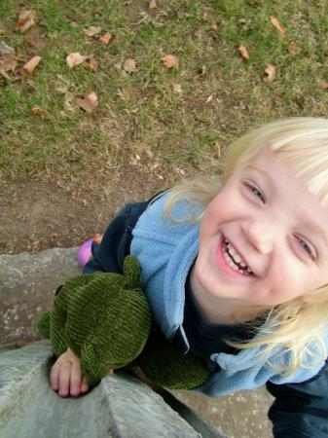
From a Culture
of Violence…
To a Culture
of Healing…

Slide 92
Needed Healthcare System Changes?
It’s not just about mental health or reducing violence, but also these problems…
  Healthcare systems, including Behavioral Health, continue to be fragmented
  Not customer-friendly or person-centered
  Not outcome-oriented
  Waste resources
  Poor communication between providers
  Practices not based on evidence
(USDHHS, 1999; IOM, 2001)

Slide 93
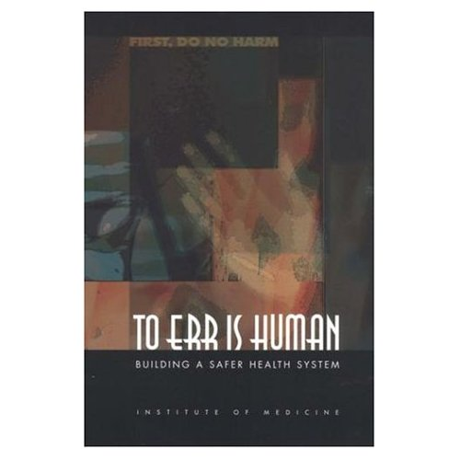
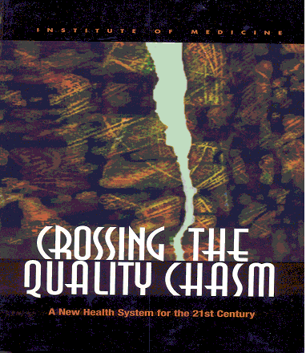
Facilitating Culture Change in U.S. Healthcare Organizations:
The IOM Reports
The U.S. Institute of Medicine described new rules to transition the redesign and improvement in health care.
  Continuous healing relationships
  Customized to individual needs/values
  Consumer is source of control
  Free flow of information/transparency
  Use of best practices
  (IOM, 2001, 2005)

Slide 94
The breach between what we know and what we do [can be] lethal.”
Kay Redfield Jamison
Night Falls West

Slide 95
The burden of harm conveyed by the collective impact of all of our health care quality problems is staggering.
Chassin et al, 1998

Slide 96
The IOM reports called for closing the research-to-practice gap in medicine.
They identified large gaps between the care people should receive and the care they do receive.

Slide 97
Change
The American health care delivery system is in need of fundamental change.
The current care systems cannot do the job. Trying harder will not work.
Changing systems of care will.
These systems need to be …
Safe, Effective, Patient-Centered,
Timely, Efficient, Equitable

Slide 98
Facilitating Culture Change
The U.S. MH New Freedom Commission Report
A Call for System Transformation
System Goal = Recovery for everyone
Services/supports are consumer-centered
Focus of care must increase consumers’ ability to self manage illness and build resiliency
Individualized Plans of Care critical
Consumers and Families are full partners
(New Freedom Commission, 2003 - chaired by our very own former Commissioner Mike Hogan.)

Slide 99
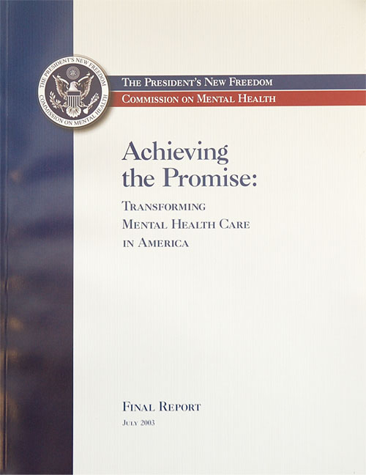
The time was long past for yet another piecemeal approach to mental health reform. Instead, the Commission recommended a fundamental transformation of the Nation’s approach to mental health care.

Slide 100
A Vision of Mental Health:
The Future in the U.S…?
Service users are employed in every setting, up to 30-50 % of staff
Treatment planning is directed by the consumer, and family, whenever possible
Language and care are “person-centered and non-discriminatory”
Evidence-based practices (EBP) are the norm, including non-coercion, effective use of meds, family education, and a treatment focus on illness self-management

Slide 101
Preventing violence, coercion, seclusion and restraint fits these calls for action and change!
We have come to believe that this work is a fundamental cornerstone in transforming our systems of care.
Effective Leadership is critical.
New staff knowledge and practice changes will set a foundation.
Changes include using evidence-based practices, including meds; creating treatment activities that teach illness management; person-directed planning; workforce development; and preventing coercion and discrimination.

Slide 102
The Point
This work - preventing violence, coercion, and restraint & seclusion - is fundamental to the principles and vision for transformation outlined in the IOM Repots and the New Freedom Commission.
This work is the foundation, absolutely key to any transformation effort.
The use of restraint & seclusion is counterintuitive to all these principles and the Vision.
Coercive or traumatizing settings do not foster hope, healthy relationships, pro-social behaviors, or trust.

Slide 103
Development of the R/S Curriculum
The curriculum we are going through emerged from the literature, expert consensus, and research that specifically tested the Six Core Strategies.
Ongoing review of literature
Qualitative reports emerged from personal experiences (self and colleagues) with direct experiences in successful reduction projects across the country
Qualitative reports emerged from service users and staff (ongoing)
Core strategies emerged in themes over time
Expert meetings held in DC in 2001, 2002, 2003, and 2007 to refine

Slide 104
What are the Main Change Constructs in Preventing Conflict, Violence, and R/S Use?
  Leadership Principles in effective change
  The Public Health Prevention approach
  Use of Recovery Resiliency Principles
  Valuing Consumer/Staff Self Reports
  Trauma Knowledge operationalized
  Staying true to CQI Principles (the ability to take risks to assure individualized treatment occurs)

Slide 105
The Public Health Prevention Model
The Public Health approach is a model of disease prevention and health promotion, and is a logical fit with a practice issue such as R/S.
This approach identifies contributing factors and creates remedies to prevent, minimize, and/or mitigate the problem if it occurs.
It refocused us on prevention while trying to maintain the safest use possible.

Slide 106
The Public Health Prevention Model applied to R/S Reduction
Primary Prevention (Universal Precautions)
  Interventions designed to prevent conflict from occurring at all by anticipating risk factors
Secondary Prevention (Selective Interventions)
  Early interventions to minimize and resolve conflicts when they occur to prevent R/S use
Tertiary Prevention (Indicated Interventions)
  Post R/S interventions designed to mitigate effects, analyze events, take corrective actions, and avoid reoccurrences
  We need to spend more time on primary prevention.

Slide 107
The Key to Effective Tertiary Prevention
  Reversing or preventing the negative consequences when, in an emergency, restraint or seclusion cannot be avoided.
  Start your debriefing with an apology:
  “We are sorry this happened.”

Slide 108
Framing the Issue
The reduction of seclusion, restraint and coercive practices requires a culture change in our mental health settings that results in far more than just prevention of R/S.
This culture change must be congruent with transformation principles.
Best Practice core strategies have been identified.
However, practice and system change is slow and difficult…for many reasons.

Slide 109
What We Now Know:
R/S reduction is possible in all mental health settings.
Facilities throughout the US have reduced use considerably without additional resources.
We know that that the effort takes tremendous leadership, commitment and motivation.
Many hospitals have reduced use to almost zero, with no extra money and without special training or assistance.
They have done it in forensic settings, OPWDD settings, dually-diagnosed populations. We have seen it and we have heard it.

Slide 110
Six Core Strategies©
  Leadership Toward Organizational Change
  Use of Data To Inform Practice
  Workforce Development
  Use of R/S Prevention Tools
  Full Inclusion of Consumers and Families
  Rigorous Debriefing
Develop a R/S Reduction Plan

Slide 111
Six Core Strategies©
More research is needed to determine definitively whether one strategy is more effective than another. What we have found is that most of the strategies have some overlap and, together, "build a culture" that replaces the use of seclusion and restraint.
NASMHPD's core faculty experts for this project would state that the leadership strategy is mandatory and that consistent and committed daily involvement by senior facility leaders is necessary for success.
Direct care staff need to be trained, but more important, facilities must have in place effective and consistent supervision processes in which managers understand the goals and the changes that need to take place; can model these new behaviors; and reward (or hold accountable) individual staff for behavior change.

Slide 112

The First Step?
Develop a Written R/S Reduction Action Plan!
Use a Prevention-Based Approach
Using CQI Principles
Individualize the Plan for Your Program
Adopt Six Core Strategies ©
Focus on primary prevention:
Do – Check – Act

Slide 113
Reducing R/S Creates a Recovery-Oriented
Standard of Care
Improves safety for recipients and staff
Teaches respect and negotiation skills
Moves from control to partnership and empowerment
Avoids re-traumatization
Creates more responsive environments for recipients and staff
Facilitates treatment
Create a recovery-oriented standard of care in line with IOM reports and New Freedom Commission recommendations!

Slide 114

Successful Reduction of R/S
Changes the way we do business
Changes the way we view our customers
Changes the way we see our own roles
Requires - and results in - a culture change that occurs over time
Requires effective leadership…

Slide 115
The single most important component in successful reduction projects:
Leadership
Only Leadership has the authority to make the changes that are necessary for success:
  …Make restraint and seclusion reduction a high priority
  …Ensure plan development
  …Reduce/eliminate organizational barriers
  …Provide or reallocate the necessary resources
  …Hold people accountable for their actions

Slide 116

Making the Transformation
“...if we wait for the moment when everything, absolutely everything is ready, we shall never begin.”
Ivan Turgenev
We urge you to take the information and develop your plan. Now is the time to start.

Slide 117
Contact Information
Many thanks to Jayne Van Bramer, who presented this information when she was Director of the OMH Office of Quality Management. Her passion for positive environments and trauma-informed care are infectious, and we hope you catch the fever!
We love to talk about reducing restraint and seclusion.
Please feel free to contact us: http://www.omh.ny.gov/omhwb/email/compose_mail.asp?tid=DQM2

