Slide 1
Medication administration
*a guide for training FOR PROVIDER
Fountain of Hope Family Services
Created by:
ND Department
of Health,
Division of
Family Health
August, 2015

Slide 2
Reviewed by:
The following information has been reviewed and approved by:
North Dakota Department of Health (NDDoH)
North Dakota Department of Public Instruction (DPI)
North Dakota Board of Nursing (NDBON)
A cross-section of ND school nurses

Slide 3
objectives
Participants will have an understanding of the ND State Statutes regarding medication administration in schools.
Participants will understand what paperwork is needed to safely administer medications in school and document the delivery of these medications.
Participants will be able to verbalize the six rights of medication administration.
Participants will know best practices of storing, handling and disposing of medications in the school setting.
Participants will successfully complete a hands-on return demonstration of medication administration.

Slide 4

purpose
The purpose of this PowerPoint presentation is to provide a guideline to aide in training non-licensed school personnel in medication administration.
    Student’s safety when administering medications is always the MAIN priority.

Slide 5
North Dakota state statutes
  ND state statute 15.1-19-23 reads as follows
    15.1-19-23. Medication program - Establishment - Opt-out - Liability - Immunity from liability. 1. The board of a school district or the governing body of a nonpublic school may establish a program for providing medication to students that includes authorizing individuals to provide medication to a student if the individual has received education and training in medication administration and has received written consent of the student's parent or guardian. 2. A teacher or classified staff member, who is not employed as a licensed health care provider to provide medication, may choose to not provide medication under the program established under subsection 1. 3. An individual authorized to provide medication under subsection 1, or a school district, the board of a school district, or the governing body of a nonpublic school that establishes a program for providing medication to students is not civilly or criminally liable for any act or omission of that individual when acting in good faith while providing medication to a student, except when the conduct amounts to gross negligence.

Slide 6
Student self-carry legislation
15.1-19-16. Asthma - Anaphylaxis - Self-administration of medication by student - Liability. 1. A student who has been diagnosed with asthma or anaphylaxis may possess and self-administer emergency medication for the treatment of such conditions provided the student's parent files with the school a document that is signed by the student's health care provider and which: a. Indicates that the student has been instructed in the self-administration of emergency medication for the treatment of asthma or anaphylaxis; b. Lists the name, dosage, and frequency of all medication prescribed to the student for use in the treatment of the student's asthma or anaphylaxis; and c. Includes guidelines for the treatment of the student in the case of an asthmatic episode or anaphylaxis. 2. Neither a private school or a school district nor any employee of the private school or district is liable for civil damages incurred by: a. A student who administers emergency medication to himself or herself in accordance with subsection 1. Page No. 4 b. An individual because a student was permitted to possess emergency medication in accordance with subsection 1. 3. For purposes of this section, "emergency medication" includes a prescription drug delivered by inhalation to alleviate asthmatic symptoms and an epinephrine auto injectable pen.
http://www.legis.nd.gov/cencode/t15-1c19.pdf?20150616125501

Slide 7
What does this mean?
School Administrators are responsible for designating someone within the school to be trained in medication administration.
Education and training must be completed by the designated staff member.
  Details regarding this training are not specific
    Who trains?
    What is the training?
    How often is the training required?
Schools cannot opt out of medication administration if:
  Student is on an IEP (Individualized Educational Program)
  Student has a 504 Health care Plan
    If a student has an IEP or 504 plan and receives federal funding, the school MUST comply with the plan and provide the means for medications to be administered.

Slide 8

North Dakota board of nursing
ND Board of Nursing frequently asked questions on school medication administration:
https://www.ndbon.org/RegulationsPractice/Practice/SchoolNsgMedAdmin.asp

Slide 9


First things first…
If a medication can be given at home and not brought into the school at all, this is ideal.
  For example: medications prescribed to be taken three times a day (TID) could be given at home before school, after school, and in late evening/bedtime.
  Discuss with parents these options before making the decision to store and administer a medication in school.
  Home before school if possible!
  (We know this isn’t always possible.)

Slide 10
Medications in school
Prescription (ordered by a health care provider…MD, dentist, nurse practitioner, physician assistant)
  ADHD meds: most are a controlled substance (oral, transdermal patch)
  Antibiotics (oral, ear drops, eye drops)
  Anti-seizure meds (oral, rectal-Diastat™)
  Diabetic meds: insulin, Glucagon® (injections)
  Asthma meds: (inhaled, oral)
  EpiPen® (injection)
  Others
OTC (over the counter) medications
  Acetaminophen (Tylenol®)
  Ibuprofen (Advil®, Motrin®, etc.)
  Cetirizine (Zyrtec®)
  Diphenhydramine (Benadryl®)
  Others
  Some schools are choosing not to administer OTC meds
Your school should have a written policy on medication administration. Be familiar with that policy, as each school may be a little different.
All prescription meds need a health care provider’s order. Check your school policy, some schools require an order for OTC meds also!

Slide 11
Bringing meds into school
Medications must be brought in by parents/guardians. Students cannot have the responsibility of bringing a medication to school.
First, determine…
  Option 1: Is this a medication that is to be stored in a locked cabinet (office or nurse’s office) that staff need to help administer
  Option 2: Is this a medication that the student carries
  and self-administers?
    Inhaler—asthmatic reactions
    Epinephrine—severe allergic reactions
    Others?
    Many times, providers will write
    a note stating that a child should
    have their rescue inhaler or Epipen®
    with them. This should also be a part of the
    medical care plan for that student.
Self-carry meds are generally those that are used in life-threatening situations and the student needs immediate access to them!

Slide 12
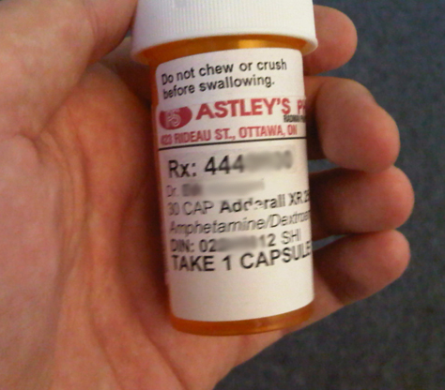
Paperwork
Paperwork valid for current school year only.
Next, make sure proper paperwork is completed.
  Medication Administration Consent Form
    Name of medication (as it appears on the medication
    bottle/container) and strength
    Dose
    Route
    When to give
    What the medication is to be given for
    Parents signature
      Special instructions…i.e. please call parent before
      administering medication.
    Written order (signed) from prescribing provider
    This can be a separate form but should be with or attached to the medication form.
      For all prescription medications
      For OTC medications (check school’s policy)…especially if “off-label” or different dose than recommended

Slide 13

Paperwork, cont.
  Self Carry/Self Administer consent form
    Signed by parent
    Signed by student (some schools require this)
  Medication Administration log form
    Each medication should have its own form. If a student is on two medications, that student should have two log forms.
    See example (next slide)
  All paperwork must match medication label. If the paperwork does not match, you will need to redo it and get the appropriate signatures again.
  Any changes in dose or medication require a new written provider order.
Each school district, school nurse, or public health department has forms that they have developed and implemented. If your district does not have something in place yet, you can develop forms that work best for you.

Slide 14
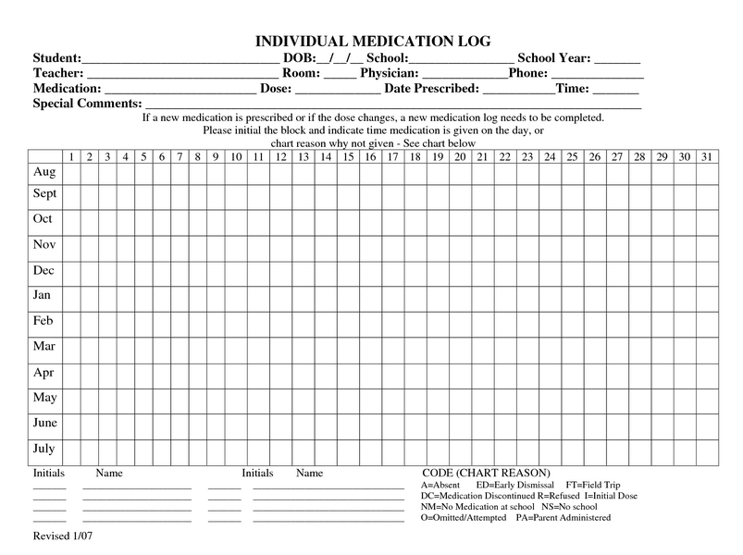
This is an example…
school nurses across the state have developed and used forms that work best for them!
Information can be “tweaked” to meet the needs of your school’s preferences
Notice codes!

Slide 15
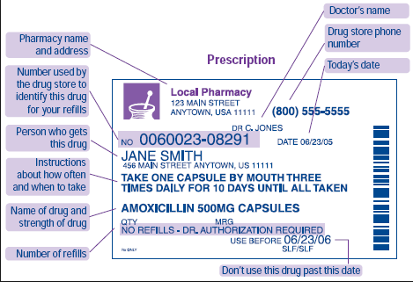
How to read a prescription (rx) label

Slide 16
Medication storage
Medication must be in the original container whether it’s prescribed or OTC.
  No medications in Ziploc® bags, spice bottles or other containers.
    Why? You need to be sure the medication is really what they say it is. You need to know the lot number, expiration date and strength.
You should document the quantity brought in.
  Count and document the quantity of the medication or if it’s an unopened bottle of pills, take note of the quantity in the bottle. For liquids, you can document how many mL’s are present when brought in.
  Controlled substances: should be counted, logged (both in and out), and recounted at least weekly to make sure there is no drug diversion.
    Drug Diversion is when licit drugs are used for illicit purposes. Basically,
    the medication is being used in an illegal manner.
    It is not uncommon for people to steal medications, especially controlled substances. You need to keep tight control of these types of medications!

Slide 17
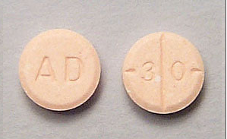
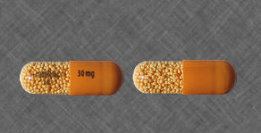

What is a controlled substance?
Controlled Substance
  Definition: a substance subject to the U.S. Controlled Substances Act (1970), which regulates the prescribing and dispensing, as well as the manufacturing, storage, sale or distribution of substances assigned to five schedules according to their 1) potential for or evidence of abuse, 2) potential for psychic or physiologic dependence, 3) contribution to a public health risk, 4) harmful pharmacologic effect, or 5) role as a precursor of other controlled substances.
  http://www.drugs.com/dict/controlled-substance.html
Adderall 30 mg
Adderall XR 30 mg
Ritalin 10 mg

Slide 18
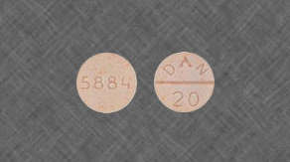
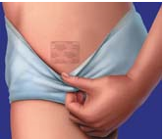
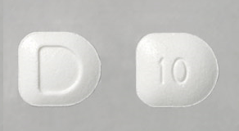
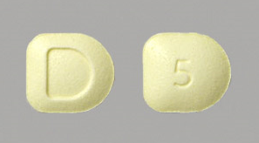
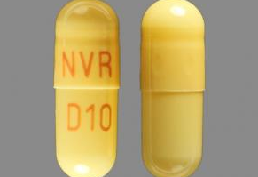
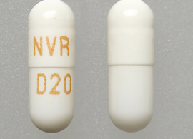
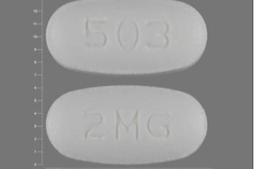
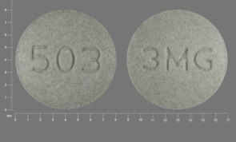
Controlled substances in schools
Ritalin 20 mg
Daytrana Patch
Focalin 10 mg
Focalin 5 mg
Focalin XR 10 mg
Focalin XR 20 mg
Intuniv 2 mg
All medication pictures from
www.drugs.com
Intuniv 3 mg

Slide 19
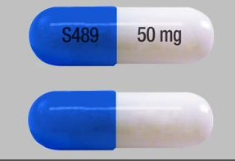
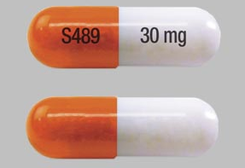
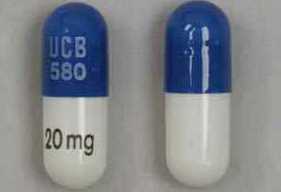
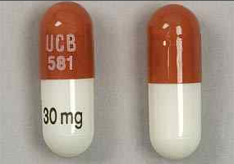
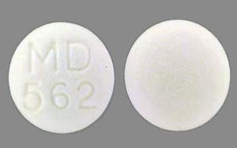
Controlled substances in schools
Vyvanse 50 mg
Vyvanse 30 mg
Metadate CD 20 mg
Metadate ER 20 mg
CD=controlled delivery
CR=controlled release
ER=extended release
LA=long acting
SR=sustained release
TR=time release
XR=extended release
XL=extended release
https://www.riverpharmacy.ca/faq/what-do-the-acryonyms-cd-cr-la-sr-tr-xl-and-xr-stand-for
Metadate CD 30 mg
All medication pictures from
www.drugs.com

Slide 20
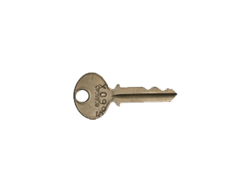
Medication storage
Locked cabinet
Locked office/room
Organized
  Many different ways to do this….what works best for you?
    Alphabetical
    Time of day meds are to be given
    The better things are organized, the less chance for mistakes!
    Clean
    Away from light/sun
    Oral medications separated from topical medications
Refrigerators:
  Medications in fridges—insulin, certain antibiotics
    Designated medication fridge (no personal food/drinks)
    Generally temps between 36º-46º Fahrenheit.
      Colder or warmer temps can change medication’s effectiveness.
double locking is best practice

Slide 21
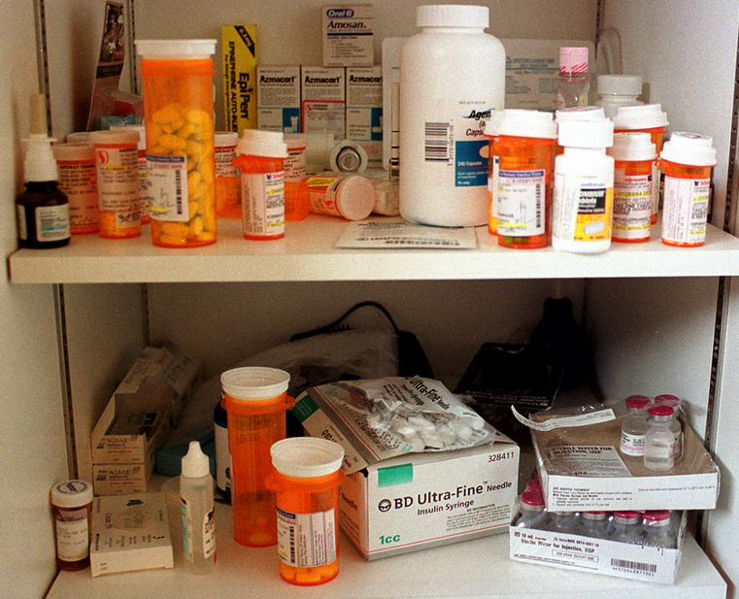
Medication storage cont.
All medications (both prescription and OTC) should have the student’s name and date of birth on them.
  You will need to hand write this on the bottle of OTC medications.
SHOULD BE:
Organized, clean and easy to read
*label with student’s name
Messy, mixed together

Slide 22
Before giving a medication
Medications are serious business…even OTC ones.
Before giving any medication, you must know and follow the 6 RIGHTS of medication administration.
  Right person (student)
  Right medication
  Right dose
  Right route (oral, ear drops, topical, etc.)
  Right time (this does make a difference)
  Right documentation (after med is administered)
Always use two identifiers prior to giving a medication…ask student:
  Name
  Date of birth
  Picture of student
  attached to paperwork:
  this is especially
  nice for back-ups.
If something doesn’t seem right, or you have questions, do not give the medication!! Call the nurse, doctor, parent or pharmacy!

Slide 23

Infection control
Prior to giving a medication, follow these steps…
  Wash hands thoroughly with soap and water or alcohol-based hand foam or gel.
    If using alcohol-based hand sanitizer, be sure to let hands dry completely before doing anything else.
  Wear disposable gloves if necessary.
    If risk of coming in contact with blood or other bodily fluids
    If you have any open sores or cuts on your hand
    If you will be touching a transdermal patch
      Medication is absorbed through the skin.
    Do not use latex gloves as some people
    have latex allergies.
      There are many vinyl glove options.

Slide 24

setting
Medication administration should be conducted in a quiet, private place.
  Privacy of student
  No distractions

Slide 25
Be familiar…
Always be familiar with the medication you are administering:
  Read package insert. You can also find detailed information on http://www.nlm.nih.gov/medlineplus/druginformation.html or www.drugs.com
  Speak with parent(s)/guardian(s) about previous experience with the medication. How has child reacted at home?
  Know the side-effects and what serious adverse reactions to watch for.
    Adverse reactions: A result of drug therapy that is neither intended nor expected in normal therapeutic use and that causes significant, sometimes life-threatening conditions. http://dictionary.reference.com/browse/adverse reaction
  Unlicensed school staff cannot administer parenteral (injectable) medications.
  There are certain exceptions in emergency situations, which will be discussed later.
  School staff CAN become an Unlicensed Assistive Person (UAP) and administer parenteral meds under the direct supervision of a nurse.
    See North Dakota Board of Nursing website for more information.

Slide 26
Oral medications
By mouth
Swallowed, chewed, dissolved under tongue
  Sometimes you have to check student’s mouth to make sure they are not hiding their medication (cheeking).
Absorption: from stomach or intestine to bloodstream and then to other parts of your body.
  Different oral medications absorb at different rates/speeds.
    Type: liquid or tablet
    Taken with food or on an empty stomach
    Special coatings
    Taken with other medications at the same time
  Doctors and pharmacists will specify the way the medication should be taken.
  Do NOT crush, break or chew any capsule or tablet
  before swallowing unless directed to do so by a
  doctor, pharmacist or per package insert.
    If unsure, ASK!
If student has trouble swallowing a pill, talk with the doctor or pharmacist for other options

Slide 27
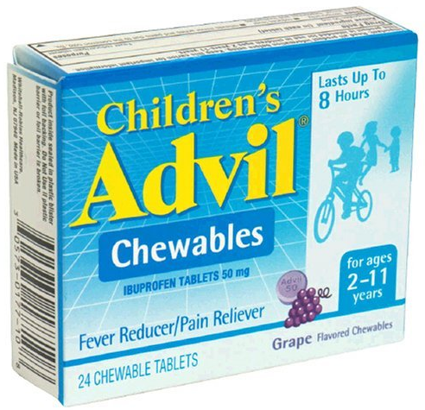
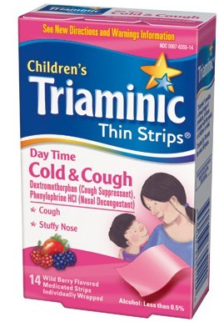
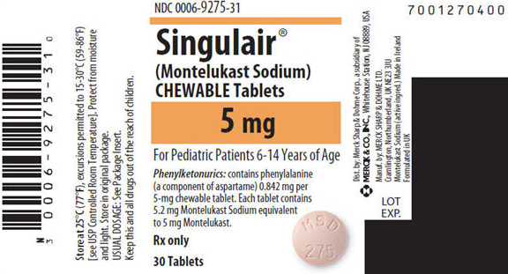
Tablets & Capsules
Most oral tablets and capsules should be taken with water.
  Rule of thumb, give with water unless otherwise directed.
Chewable tablets should be chewed until they are dissolved completely. They are not meant to be swallowed.
Some “soft chew” medications are meant to melt in your mouth or be chewed.

Slide 28

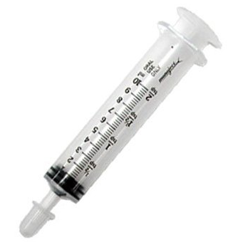
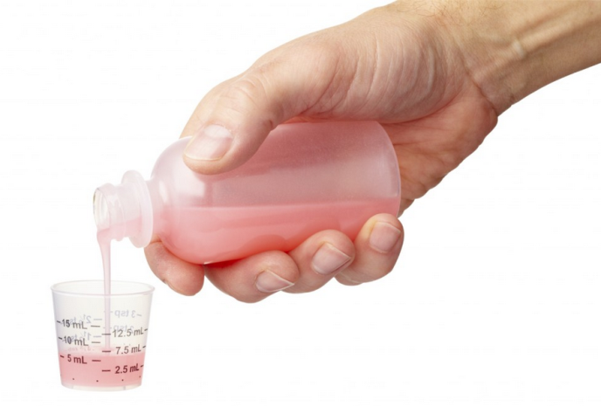
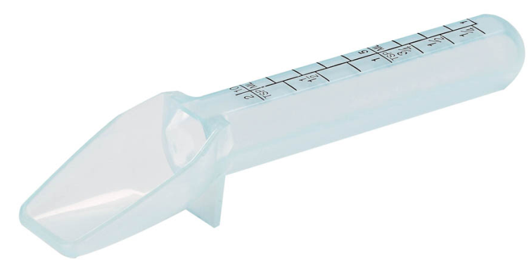
Liquid medications
Liquid medications:
  Only use measuring devices made for medications.
    Household teaspoons are not an accurate method to measure meds.
  Shake the bottle if indicated as some medications settle to the bottom.
  Measure at eye level.
    Place on flat surface and crouch down so you are eye level with the measuring device (preferred method).

Slide 29
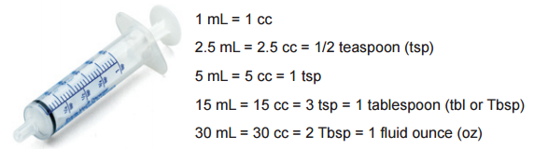
Know your conversions
Be sure you know the correct dose. Don’t guess!

Slide 30
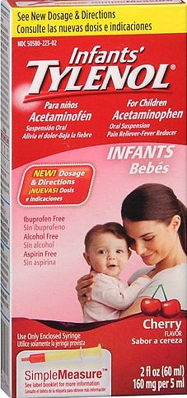
Know difference in strengths
The same medication can come in different strengths. For example, let’s look at Tylenol…
160 mg per 5 mL

Slide 31
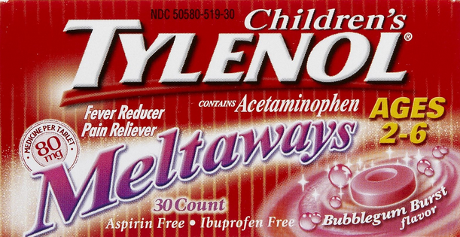
strength
80 mg per tablet

Slide 32
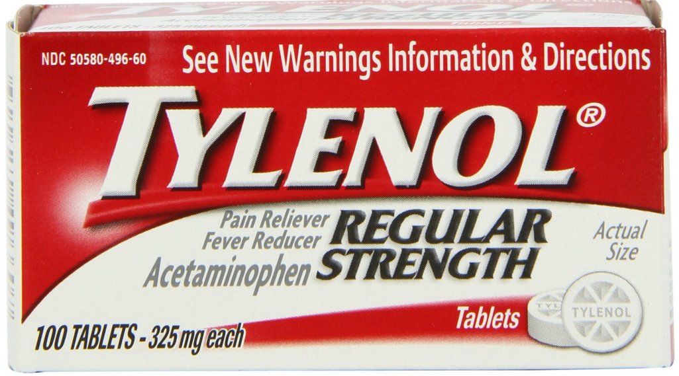
strength
325 mg per tablet

Slide 33
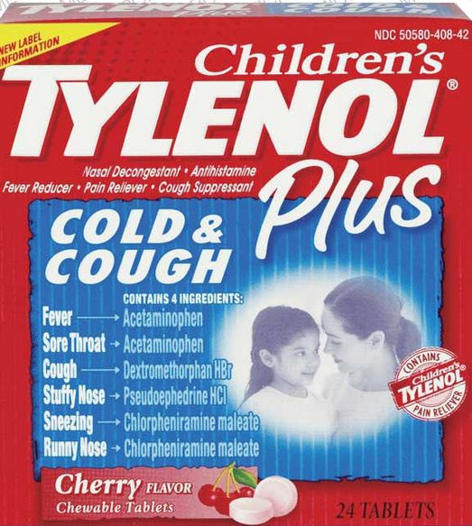
strength
Many cold medicines have acetaminophen (Tylenol®) in them also. Be careful not to
double up.
Giving regular Tylenol® along
with Tylenol® cold medicine
could lead to an overdose!
This is why it is a good idea
to speak with parents before
giving a PRN (as needed)
medication…to make sure nothing
was given at home earlier in the morning.

Slide 34

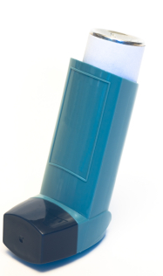
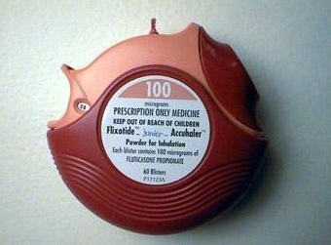
Inhaled medications
Inhaled medications are generally those used to treat asthma.
  Inhalers:
Metered Dose Inhaler
Dry Powder Inhaler
Metered Dose Inhaler with Spacer

Slide 35
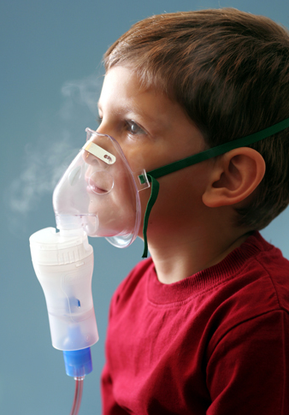
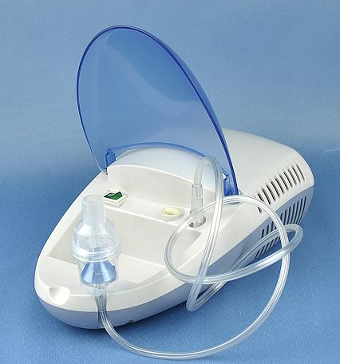
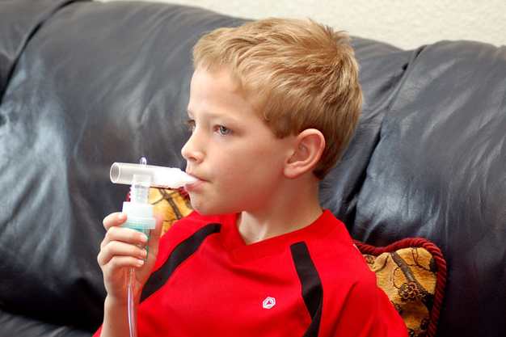
Inhaled medications
Nebulizers:
Nebulizer
Machine
Mask
Mouthpiece

Slide 36

Metered dose inhaler with Spacer
If you have trouble getting the video to play, copy and paste
this link in your internet browser:
https://www.youtube.com/watch?v=ma_cmlU9DxU#t=24

Slide 37
Dry Powder inhaler
If you have trouble getting the video to play, copy and paste
this link in your internet browser:
If you have trouble getting the video to play, copy and paste
this link in your internet browser:
If you have trouble getting the video to play, copy and paste
this link in your internet browser:
https://www.youtube.com/watch?v=_Sc7j9iW9TM

Slide 38
Nebulizer with mouthpiece
If you have trouble getting the video to play, copy and paste
this link in your internet browser:
https://www.youtube.com/watch?v=07inzRroRVQ

Slide 39
Nebulizer with mask
If you have trouble getting the video to play, copy and paste
this link in your internet browser:
https://www.youtube.com/watch?v=9ezTnY00rI4

Slide 40

Ear drops
See additional handout
  Wash hands.
  Child should lie or sit with affected ear facing up.
  After administering, have child remain lying down for 1-2 minutes.

Slide 41

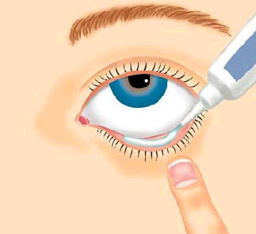
eye medications
See additional handout
  Wash hands.
  Lay down or tilt head back.
  Don’t touch eyeball with dropper or
  tip of tube.
  After administering, ask child to
  close or blink eyes for a minute.

Slide 42

Remember…
THE 6 RIGHTS…
RIGHT STUDENT (PERSON)
RIGHT MEDICATION
RIGHT DOSE
RIGHT ROUTE
RIGHT TIME
RIGHT DOCUMENTATION

Slide 43

Emergency situations
Sometimes, medications that are not normally given by non-licensed personnel, need to be given. Examples…
  Diabetic hypoglycemia—low blood sugar (Glucagon, injection)
    Signs and symptoms; must have emergency care plan.
  Anaphylactic reaction—severe allergic reaction (EpiPen®, injection)
    Signs and symptoms; must have emergency care plan.
  Non-stop seizures—acute repetitive seizures (Diastat®, rectal)
    Signs and symptoms; must have emergency care plan.
These are all emergency situations and the administration of these medications can and will save lives!
  Do or Die

Slide 44
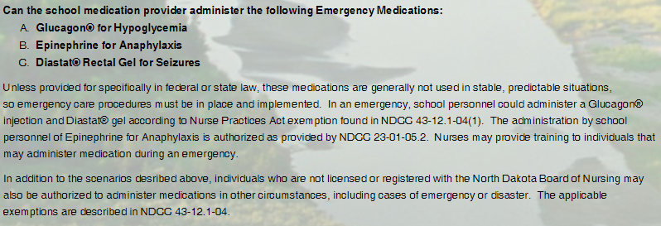
Nd board of nursing
ND Board of Nursing: Emergency Medications
Emergency Care Plan must be in place.
School staff should be trained.
Nurses can provide training; NOT considered delegation.
Updated 11/14

Slide 45
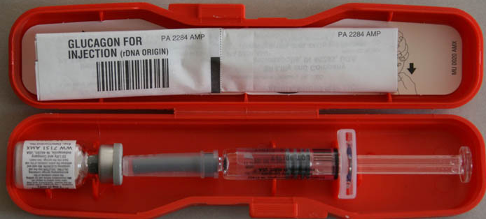
glucagon
rDNA origin (hormone)—used for severe hypoglycemia
How to administer Glucagon
http://pi.lilly.com/us/rglucagon-ppi.pdf (can print)
  Phone app available.
Automatic 911 call
  Give medication first and then call 911 if you are by yourself.

Slide 46
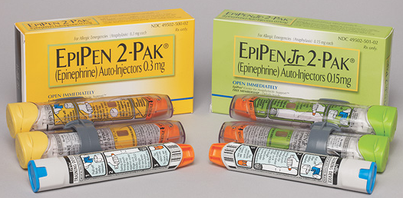
epipen®
Epinephrine—used for anaphylactic reaction
How to administer an EpiPen®
https://www.epipen.com/en/about-epipen/how-to-use-epipen
  Information
  Video
  Can order trainer kit
  Phone app available
Automatic 911 call
    Give medication first and then
  call 911 if you are by yourself.

Slide 47
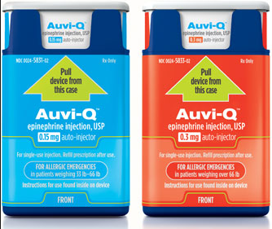
Auvi-q®
Epinephrine—used for anaphylactic reaction
How to administer Auvi-Q®
  Voice instructions
  https://www.auvi-q.com/auvi-q-demo
  Phone app available
Automatic 911 call
    Give medication first and then
  call 911 if you are by yourself.

Slide 48
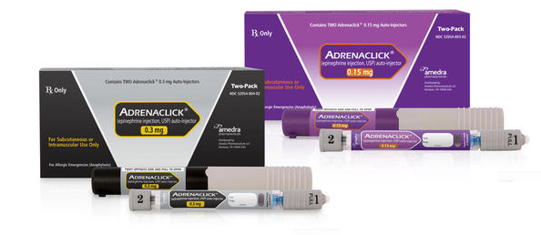
adrenaclick®
Epinephrine—used for anaphylactic reaction
http://adrenaclick.com/how_to_use_adrenaclick_epinephrine_injection_USP_auto_injector.php#
  Video
  Order trainer kit
Automatic 911 call
    Give medication first
    and then
  call 911 if you are
  by yourself.

Slide 49
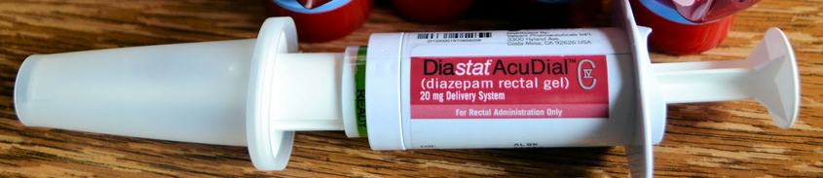
diastat™
Diazepam rectal gel—used for acute repetitive seizures
How to administer:
http://www.diastat.com/Portals/21/Pdf/Ped%20admin.pdf
  (can print)
Automatic 911 call
    Give medication first and then
  call 911 if you are by yourself.

Slide 50
Medication errors
There are many different kinds of medication errors.
  Giving too much medication (overdose)
  Giving too little medication (under dosing)
  Giving the wrong medication
  Incorrect route
  Incorrect time
  Incorrect patient
  Missed dose
    If a student doesn’t show up to get their medication, you need to track him/her down and administer the medication. It is not ok to just not give it.
    If a medication error occurs, you must contact the parent/guardian immediately. You may also need to contact the doctor, pharmacy or in some cases, poison control.

Slide 51

Poison control

Slide 52

Medication error report form
When a medication error occurs, a medication error report form or variance report should be completed.
  This serves to examine how this error occurred and what could have been done or can be done in the future to prevent it.
  This serves as documentation of what the error was, who was notified, if there were adverse effects on the student, etc.
It can be very difficult to admit that you made a mistake. When it comes to medication, you have no choice but to notify the correct people…parent, doctor, pharmacist, school administrator, etc. There can be serious adverse reactions and those need to be addressed.

Slide 53
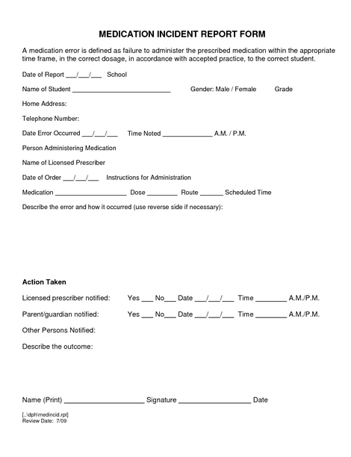
This is just one sample. Many public health units and school nurses already have a form developed. If your school does not have one, you should develop one to use.
Even “near misses” can
be and should be documented.
A near miss is when an error didn’t occur, but it almost did.

Slide 54
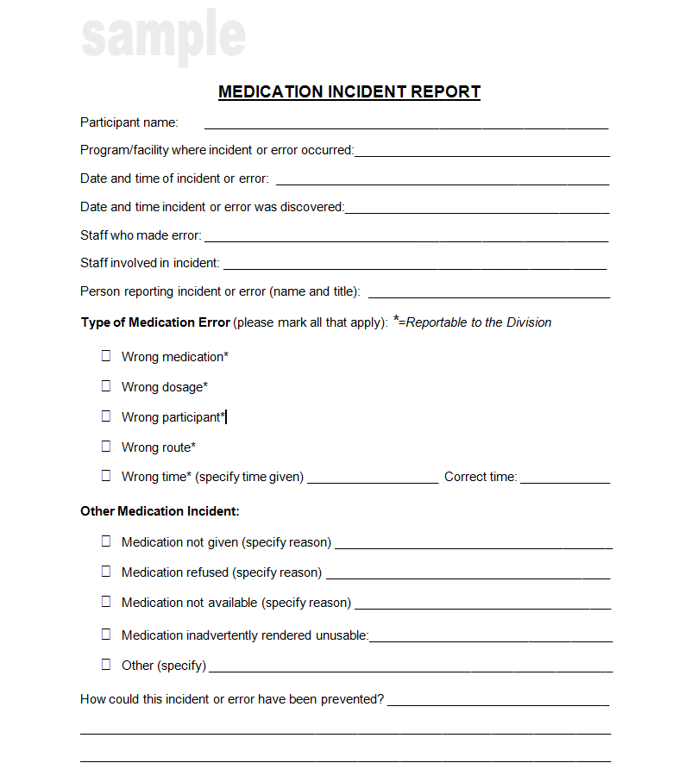
This sample form has check boxes to choose what the error was.

Slide 55


Do’s and don’ts
DON’T…
  Give a student somebody else’s medication
  Skip a dose
  Crush or break pills unless instructed to by a medical provider/pharmacist
  Change the dose or timing
  Give medication that is not in original package, bottle or container
DO…
  Know the medication you are giving
  Give the medication exactly how it’s prescribed
  Have a written order from a medical provider
  Follow the 6 Rights
  Use two student identifiers
  Watch expiration dates
  Lock medication cupboard
  Give in private, non-distracting setting

Slide 56

documentation
Factual information, no opinions.
Never white out, scribble over, cover up, or erase what has already been written.
If error in documentation, draw single line through incorrect information and initial.
Don’t use abbreviations.
Write legible so it is easy to read.
Black or blue ink is best, if handwritten. No pencil.
Computerized: nothing that has previously been a part of the student’s medical file should ever be deleted.
RULE OF THUMB…
  “IF IT’S NOT DOCUMENTED, IT’S NOT DONE”!

Slide 57

Privacy acts
Family Education and Privacy Rights Act of 1974
  FERPA:
  http://www2.ed.gov/policy/gen/guid/fpco/ferpa/index.html
Health Insurance Portability and Accountability Act of 1996
  HIPAA:
  http://www.hhs.gov/ocr/privacy/
  Health information should only be shared for purposes such as continuation of care, to protect the health or safety of the student, emergency situations, etc.
    NEED TO KNOW BASIS

Slide 58

End of year
ALL medications must be picked up by the parent/guardian at the end of the year.
  Do not send the meds home with the students.
  Proper notice should be given regarding the
  medication pick-up procedures.
  Any medications not picked up should be
  destroyed or taken to an appropriate place.
    Certain medications, such as pain or fever reducers
    (not controlled substances), could be donated
    to a free clinic.
    Utilize drug take-back programs (many times these are conducted by local law enforcement in conjunction with U.S. Drug Enforcement Administration).

Slide 59
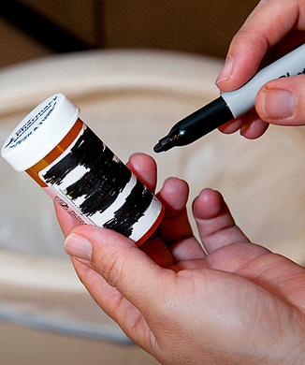
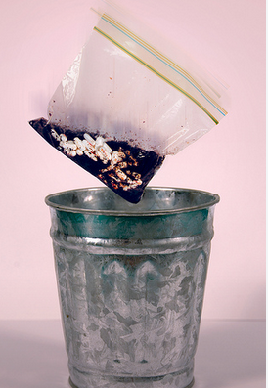
Drug disposal
See the U.S. Food and Drug Administration (FDA) website for further details on drug disposal.
http://www.fda.gov/ForConsumers/ConsumerUpdates/ucm101653.htm#guidelines
Check prescription drug label to see if there are specific disposal instructions.
Otherwise, follow these generic instructions:
  Do Not flush meds down the sink or toilet unless you are specifically instructed to do so.
  Remove med from original container and mix with an
  undesirable substance…e.g. coffee grounds, kitty litter.
  Place mixture in a sealable bag, container or can
  and throw in garbage.
  Make sure any personal information is not visible on
  the prescription bottle and throw in garbage.

Slide 60


Questions?
Contact your school nurse
Contact your local public health unit
Contact the nurse who presented this information
Contact the North Dakota Department of Health:
Division of Family Health
  Renae Sisk, RN, BSN
  Maternal Child Health/State School Nurse Consultant
  600 East Blvd. Ave., Dept. 301
  Bismarck, ND 58505-0200
  Email: rsisk@nd.gov
  Phone: 701.328.4526

Slide 61
Post Test
A student brings a baggie of Tylenol® to the school secretary stating that his mom said to drop it off at the office because he has been struggling with headaches. Mom told him if he needs it throughout the day, the secretary can administer it. What is incorrect about this scenario?
  Student brought medication in. Medications should always be brought in by parent or guardian.
  Medication was not in original container.
  Parent did not sign a medication administration consent form.

Slide 62
Post test
A guardian brings in a prescription bottle of Metadate ER 20 mg. All appropriate paperwork, including a written order, was completed. The guardian states that the child has trouble swallowing the pill and it should be crushed and mixed with pudding so that the student can swallow the medication better. What is incorrect about this scenario?
  ER means extended release and these types of pills should never be crushed (unless ordered by a medical provider or pharmacist). By crushing the pill, it will disrupt the timing that the medication is supposed to be released throughout the body.

Slide 63
Post test
A student presents to the school office at 10 a.m. complaining of a bad headache. The school principal, who is the trained medication administration staff member, looks and sees that the student does have Ibuprofen and all of the completed paperwork for this medication. The parent signed the consent form and the student is to receive 1 tablet or 200 mg. The principal gives the student the Ibuprofen tablet after confirming it was the correct student, medication and dose. What is incorrect about this scenario?
  The principal did not call the parent or guardian to determine if the student had received any medications earlier in the day. By failing to do this, there is potential that the student could be getting too much Ibuprofen (overdose).

Slide 64
Post test
A fourth grade boy with ADHD has run out of his Intuniv. The school secretary has contacted his dad and dad is in process of getting a prescription refill, but it won’t be ready until the next day. In the meantime, the boy is really struggling and so is his teacher. There is another student who takes Intuniv and has plenty of medication at school. The secretary decides she can borrow one days worth of Intuniv from this other student and re-pay him as soon as the boy gets his new prescription. That way the boy and the teacher will have a better day. What is incorrect about this scenario?
  The secretary gave the student another student’s medication. You can NEVER give somebody else’s medication to a student.

Slide 65
Post test
A student, who is severely allergic to bee stings, was stung while at recess. The school nurse is not at that school that day so the student is brought to the office. There is an emergency care plan for the student. It states that an EpiPen Jr. is available and should be administered immediately if the student is stung…even if there aren’t any immediate symptoms. But, the secretary remembers that she is not supposed to give injections. Should she give the EpiPen Jr.?
  YES!! This is one of those emergency situations and an exception for administering parenteral (injectable) medications. The secretary SHOULD administer the epinephrine then call 911 immediately.

Slide 66
Post test
A parent brings in some regular strength Tylenol for her 9 year old daughter. She completes the appropriate paperwork with the school secretary. According to the label on the Tylenol, the correct dose for the girl is 1 tablet or 325 mg. Mom states that she always gives her daughter 2 tablets or 650 mg because that works better for her. Can you give the girl the 650 mg (2 tablets)?
  NO, you cannot administer medication off label. This means not following the recommended directions. If mom insists on 2 tablets, she will have to administer the medication or you will have to get a written order from the girl’s healthcare provider stating that that dose is appropriate. You cannot administer the increased dose until the written order from the healthcare provider is returned.

Slide 67
Post test
The school nurse suddenly got the stomach flu and had to leave for the day. A diabetic student is just finishing lunch and needs her insulin. The school secretary has been trained in medication administration. Can she give the insulin?
  No, insulin is a parenteral (injectable) medication and cannot be administered by the secretary. It is NOT an emergency medication.
  In this case, a nurse, UAP (Unlicensed Assistive Person, under the direction of the nurse) or parent must be the one to administer the insulin.
    Of note…school staff CAN become a UAP if there is direct supervision by a licensed nurse. See the North Dakota Board of Nursing website for further information…
      https://www.ndbon.org/UAP-MAIII/UAPRegistryFAQ.asp

Slide 68
Post test
A student is scheduled to come to the office for his ADHD medication, Ritalin, at lunchtime. He doesn’t show up so the trained medication administration staff member thinks to himself, “I guess missing one day won’t hurt, I will make sure he gets his dose tomorrow.” Is this ok?
  No, it is not ok to let a student skip their medication dose. The student will need to be tracked down so that he can receive his medication.

Slide 69
Post test
A student is on Keppra, a seizure medication, for epilepsy. The student has a medical care plan, the medication, and all of the appropriate paperwork for that medication in the front office. The student is to get 125 mg in the morning and 125 mg in the afternoon for a total of 250 mg per day. The trained medication administration staff member realizes that today she accidentally gave 250 mg each time, so 500 mg for the day. What should she do?
  Admit the mistake right away.
  Call the parent immediately.
  Call the medical provider (who prescribed the medication) or pharmacist to get instructions as to what needs to be done.
  Complete a medication error form and document everything that happened.

Slide 70
Post test
A student is in the front office to receive his Metadate from the school secretary. There are two other students sitting by the principals office, a parent waiting to talk to the secretary and a custodian fixing a burned out lightbulb in the same area. The meds are stored in the vault. The secretary unlocks the vault and the student is handed a medicine cup with his medication. Suddenly, a teacher yells down the hall asking the secretary for help. She takes off down the hall to help the teacher. What is wrong with this scenario?
  Busy area—medication administration should be in a quiet, non distracting environment.
  This area does not provide privacy for the student who is taking the med.
  Other students, parents, and staff could see exactly where the medications are stored.
  The secretary ran off without locking the vault again. Other people now have access to the medications.
  The secretary didn’t observe the student taking his medication. Did he really take it? Did he pocket it? Did he give it to another student?

Slide 71

Certificate of completion
This is to certify that:
(Name)______________________________________________
Has completed the training on Medication Administration in the School Setting for the _________ school year.
Instructor Signature_______________________________ date___________
(Must be an RN)
Trainee Signature_________________________________ date___________

